Slide 1
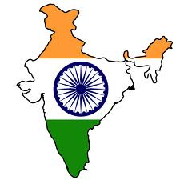
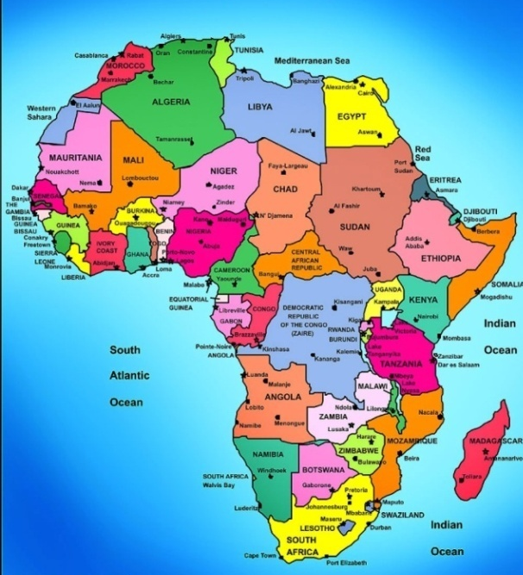
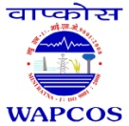
10th CII-EXIM BANK CONCLAVE
ON INDIA AFRICA PROJECT PARTNERSHIP
NEW DELHI, MARCH 2014
PARTNERSHIP FOR ENERGY AND
SUSTAINABLE DEVELOPMENT
ISO 9001:2008
(A Govt. of India Undertaking- Ministry of Water Resources)
International Consultants in Water Resources, Power and Infrastructure
ANUPAM MISHRA
SR. GENERAL MANAGER

Slide 2
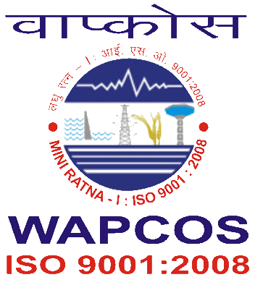
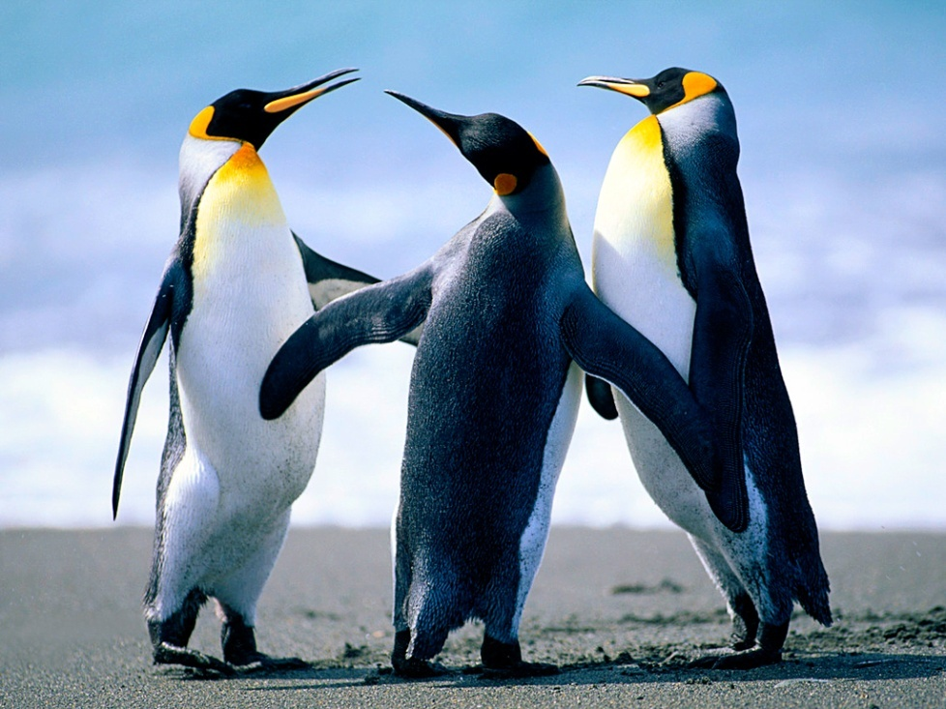
What is SUSTAINABLE DEVELOPMENT?
Development essentially is a process by which the existing potential is realized and become Apparent.
Sustainability in simple word means capacity to keep up and keep going for ever.
Hence the Sustainable development can best be described “Development which meets the need of the present without compromising the ability of future generations to meet their own needs”
2

Slide 3
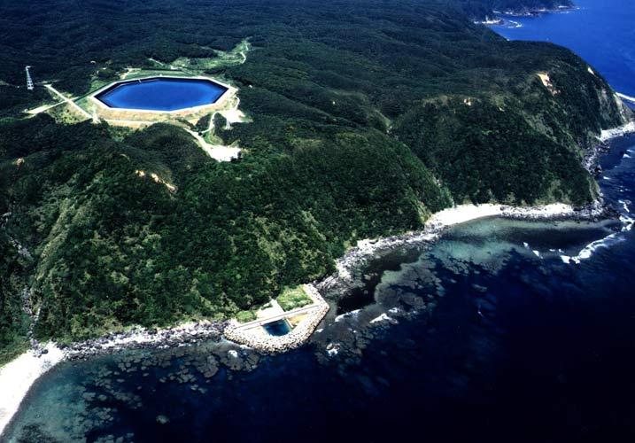
SUSTAINABLE ENERGY- NOT MW NUMBERS BUT IT SUPORTS LIFE
1 MW CAN TRANSLATE INTO
Lighting 1000 households
100 cottage Industries
Irrigating 900 Ha land
Production of 5000 MT food grains
Drinking water for 10,000 people
3

Slide 4
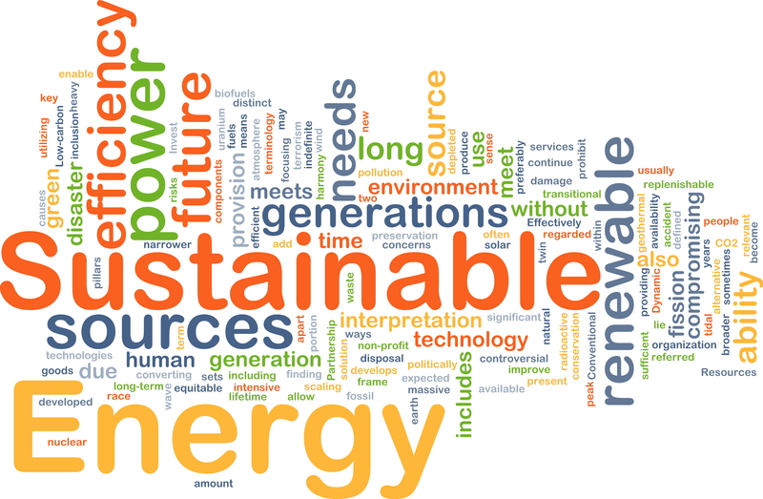
Energy and Sustainability…

Slide 5
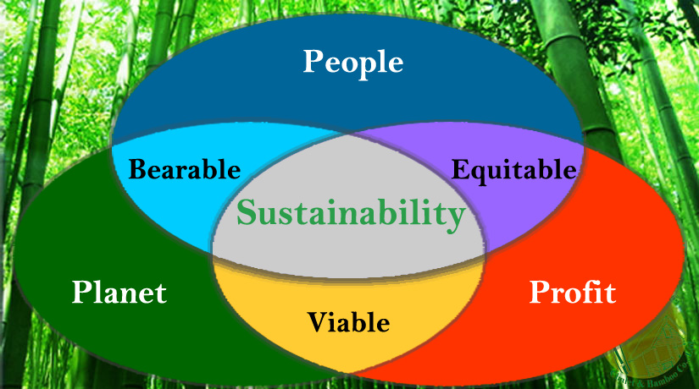
SUSTAINIBILITY PARADIGM

Slide 6
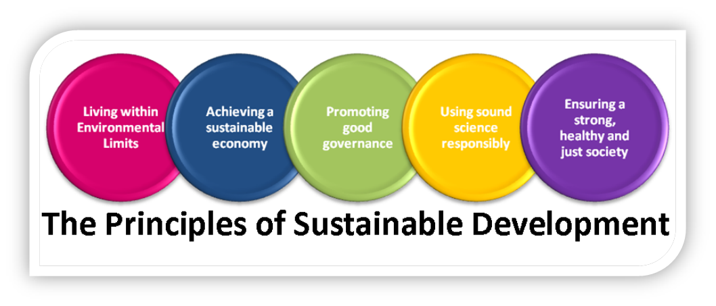
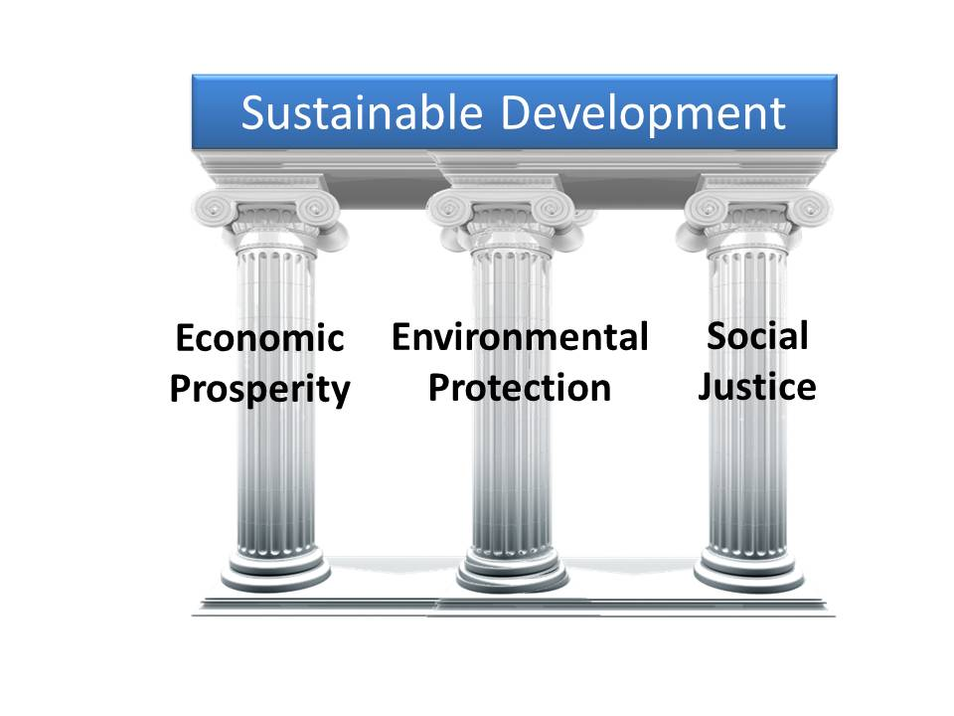
SUSTAINIBILITY – AN INSIGHT
PILLARS OF SUSTAINIBILITY

Slide 7
14

Slide 8
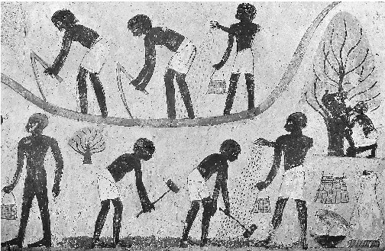
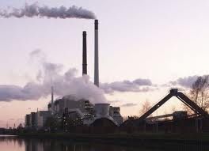
Evolution-Power Development
Mankind has been exploring various power means to meet their needs.
In the beginning - to meet Basic & Primary requirements.
Increased Population-increased power requirement
Demand met largely with fossil fuels .
Today Power is synonymous with growth and development.
4

Slide 9
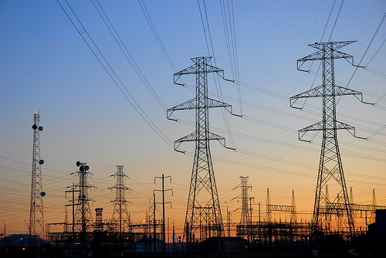
World Electricity Scenario-At a glance
TWh
TWh
Aaaaaaaaaa
aaaaaaaaaa
Africa’s Power contribution in World
5

Slide 10
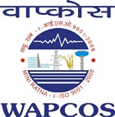
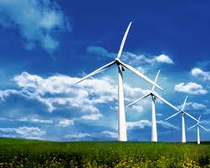
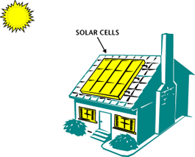
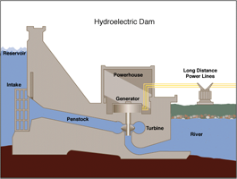
Need for Alternatives
Fossil fuel Power - finite , limited & depleting.
Power generation from fossil fuels-Emission of Green House Gases .
Adverse impact - Climate Change .
Fossil Fuel Power Model- Unsustainable
Search for alternatives -Renewable, Cleaner & MOST IMPORTANTLY SUSTAINABLE POWER
Hydro-Power, Solar, Wind – Green ,Clean and perpetual in Nature
HYDRO POWER – A GOOD ALTERNATIVE
Hydropower-Most Attractive, Sustainable, Technically proven and Affordable alternate.
6

Slide 11
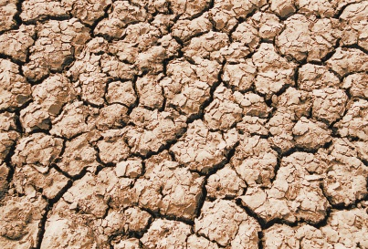
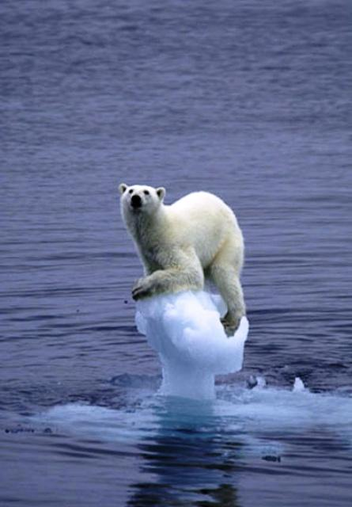
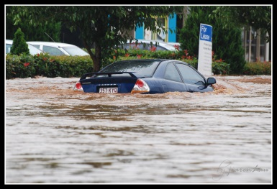
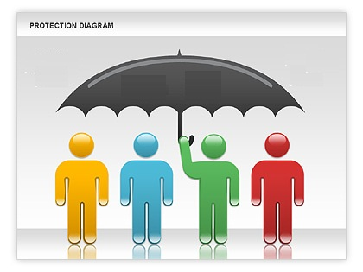
KEY ADVANATAGES OF HYDROPOWER
Perpetual in Nature
Affordable
Mitigates Climate change
Flood and Drought protection.
Supports biodiversity
Provides Peak Power
Large potential Available
Reduced Global Warming-Supports Water preservation
Flood
Drought
Climate Change
7

Slide 12
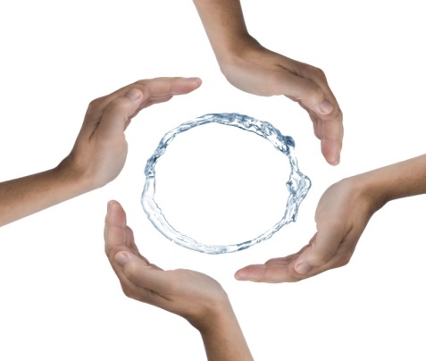
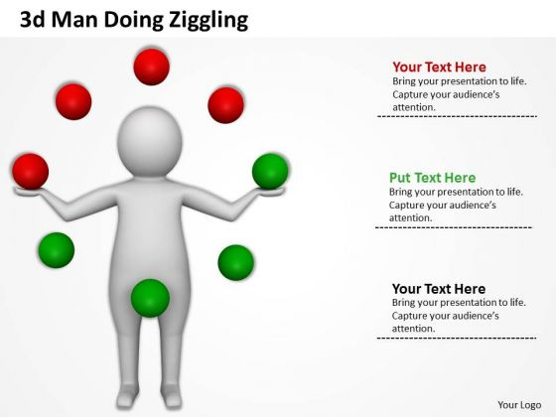
HYDROPOWER- SUPPORTS PRESERVATION OF WATER RESOURCES
Preservation of water Ensures basic needs such as:
Drinking water
Irrigation supplies
Ecological requirements
Food security, etc.
Continuous Water Availability along with Energy supply offers :
Source of livelihood
Furthering education/literacy
Sustainable power development
8

Slide 13
SCOPE OF HYDROPOWER GENERATION IN AFRICA
Hydropower Scenario – Africa exploits only 7% of its Hydro Potential
TECHNICAL POTENTIAL
ECONOMICAL POTENTIAL

Slide 14
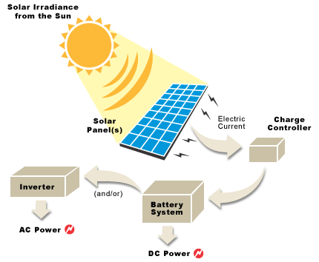
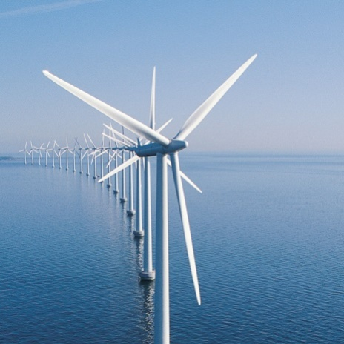
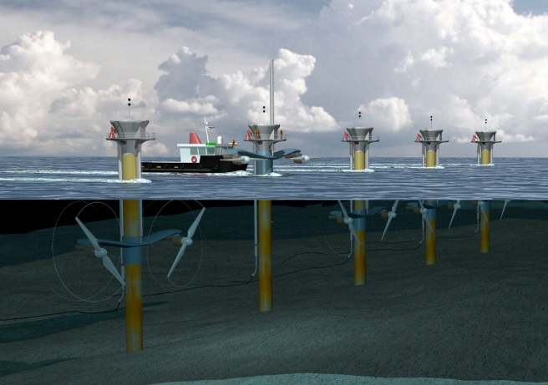
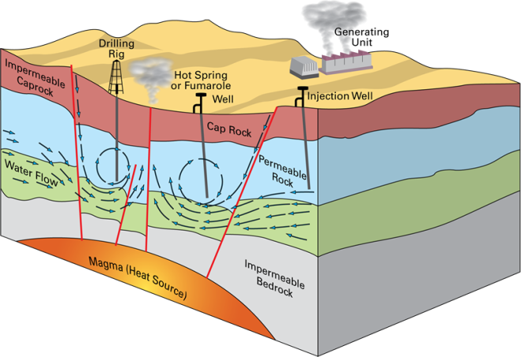
Opportunity for
Other Renewable sources
of Power in Africa
Solar Energy
Most countries receive 325 days per year bright sunlight.
Energy could be delivered, virtually anywhere without large scale grid level infrastructure
Wind & Tidal Energy
Long Coastline
Vastly underutilized as of now
Geothermal Energy
Vast potential in many East African countries
10

Slide 15
Challenges
PROJECT DEVEOLPEMENT GAPS - BIGGEST IMPEDiMENT TO DEVELOPMEMT
FINANCING IS AVAILABLE BUT BANKABLE PROJECTS ARE NOT AVAILABLE
EXPECTATIONS FROM THE DPRs
CONSULTANTS QUALIFICATIONS
Balancing private and public sector interests
Transparency and investor Confidence
Pursuit of sustainable economic and social benefits.
Global financing Options
Understanding of the Sector Dynamics
Experience in Emerging markets
Capability to provide State of the art technology, cost effective solutions.
On time Implementation
Willingness to go “THE EXTRA MILE”
11

Slide 16
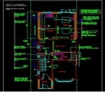
Project Conceptualization
Reconnaissance Survey & Preliminary data collection
Techno-economic Analysis
Modernization & Rehabilitation
Feasibility Study
Assessment of Water Resources & Water Requirement
Viable Project
LIFE CYCLE OF PROJECTS
Environmental Studies
EIA; EMP & R&R
Baseline Surveys
Detailed Surveys & Investigations
Commissioning & O&M
Detailed Project Report
WR Policy Framework & Support measures
Preparation of Engineering design and Drawings
Construction
Socio-cultural & Gender aspects
Economic and Financial Analysis
Project Management
Contract Management,
Construction Supervision,
Quality Control
Institutional & Policy Aspects
Cost Estimates
Tender Engineering, Construction Drawings
16

Slide 17
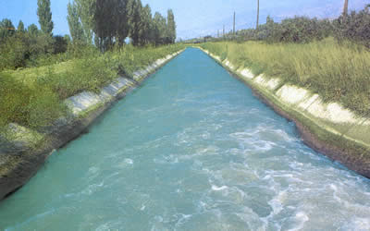
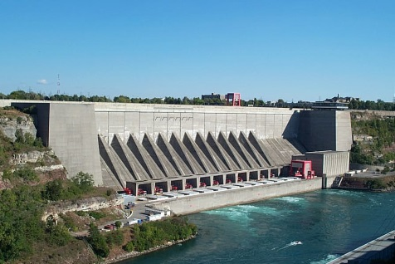
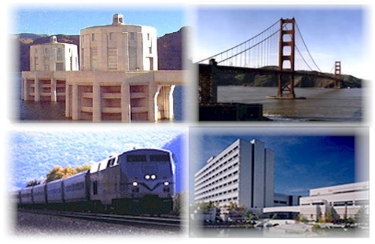
WAPCOS - A Synonym For Water & Power
A Govt. of India Undertaking, Ministry of Water Resources
Since June, 1969
MAJOR FIELDS OF SPECIALIZATION
WATER RESOURCES
Irrigation, Drainage and Water Management
Power
Hydro Electric Projects
Infrastructure
Water Supply and Sanitation
Ground Water Exploration and Minor Irrigation
Flood Control and River Morphology
Water Bodies and Lakes Conservation
Agriculture Including Dry Lands Farming
Thermal Power Projects
Transmission & Distribution
Rural Electrification
Environmental Engineering
Ports & Harbors and Inland Waterways
Urban and Rural Areas Development
System Studies and Information Technology

Slide 18
Wapcos - Spectrum of Services
From Concept to Commissioning
Preliminary Investigations / Reconnaissance
Feasibility Studies / Planning / Project Formulation
Baseline and Socio-Economic Surveys
Field Investigations and Testing
Engineering Designs, Drawings and Tendering Process
Contract Management and Construction Supervision
Operation & Maintenance
Institutional / Human Resources Development

Slide 19
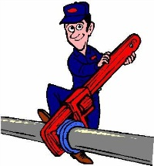
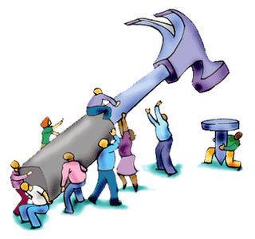
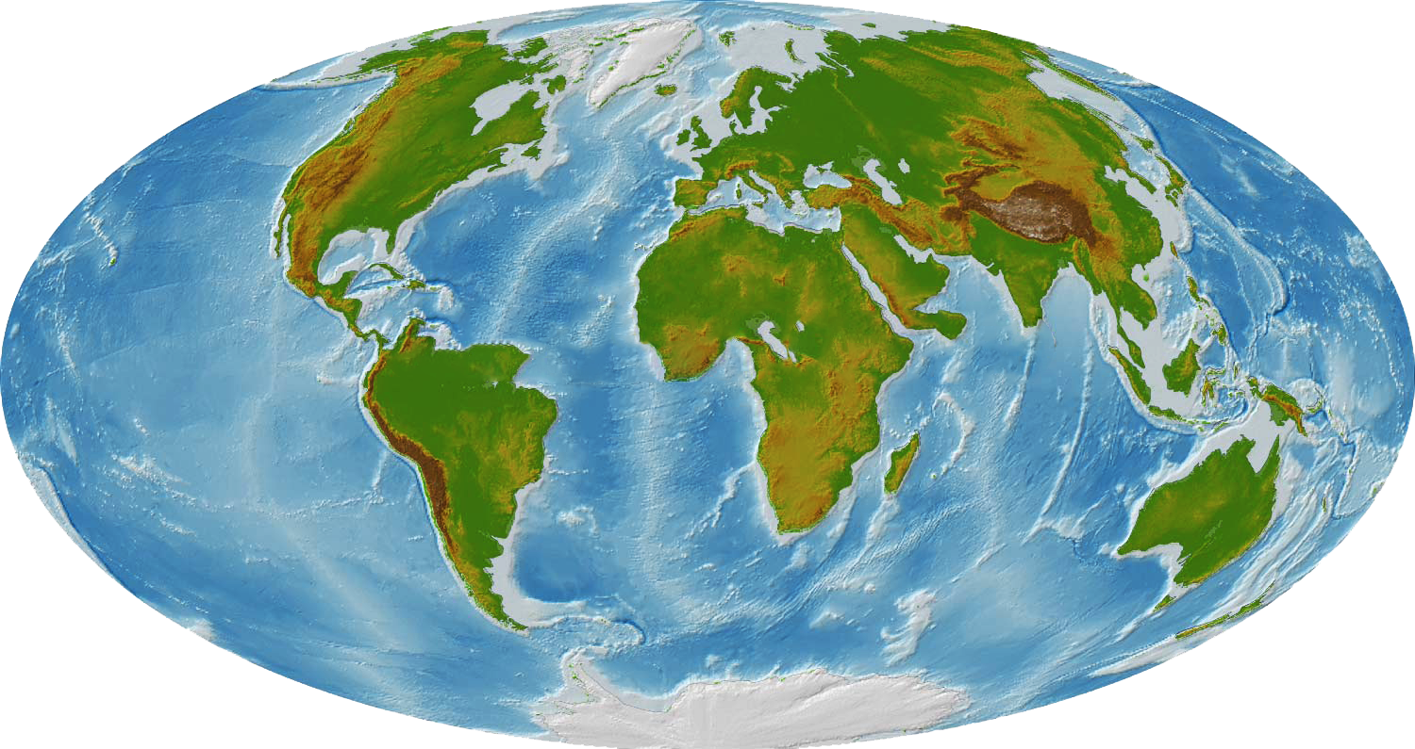
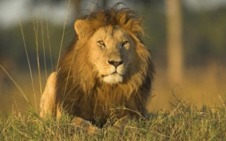
WAPCOS’ Operations - In Hydropower
51 Hydropower Projects – successfully executed
17 Countries
20,000 MW
WAPCOS -
As a Brand name
WAPCOS – An Active Player in African continent
13 Hydropower Projects – On going
(Under various stages)
Intend to be a part
of these smiles
6 Countries

Slide 20
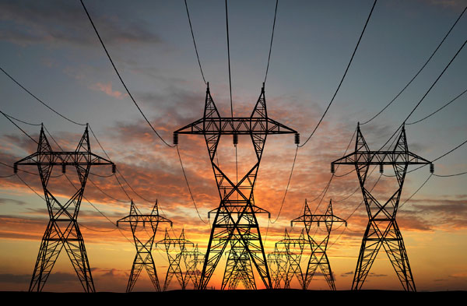
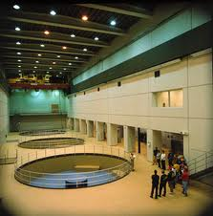
POWER SECTOR
Surveys & Investigation/Detailed Project Reports & Project Management Consultancy for
USP
Overseas
India
Over 43 Hydro Power Projects with an installed capacity of more than 8000 MW
7 Thermal Power Projects with an installed capacity of more than 11000 MW
51 Hydro Power Projects in 17 Countries with an installed capacity of more than 20,000 MW
8 Thermal Power Projects with an installed capacity of more than 2900 MW
17 Transmission Projects
15
20

Slide 21
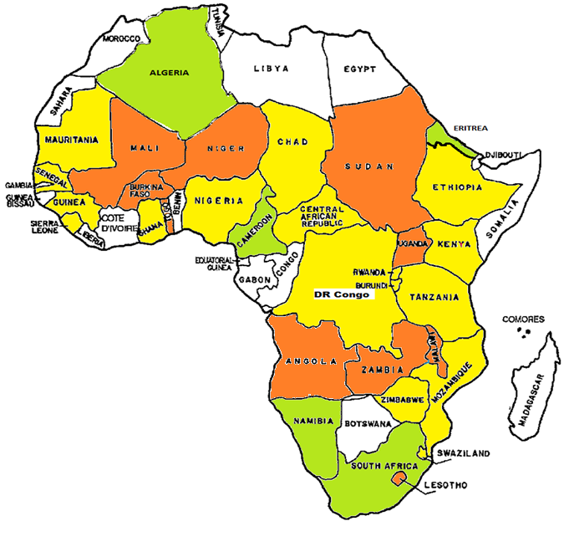
WAPCOS PARTNERSHIP WITH AFRICA
Niger
ONGOING PROJECTS
COMPLETED PROJECTS
NEW PROJECTS
21

Slide 22
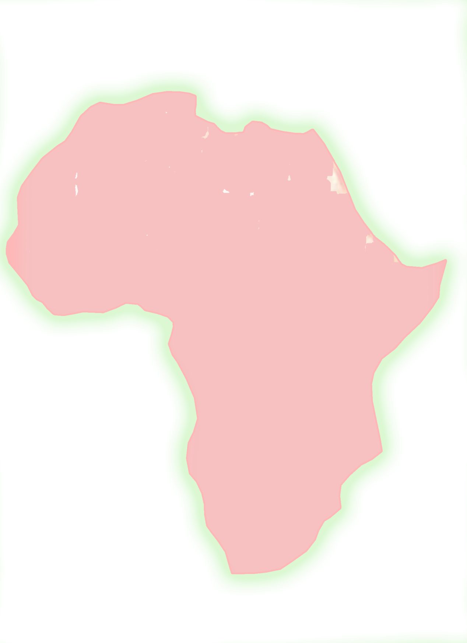
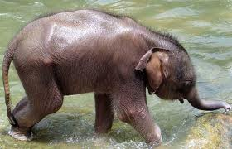
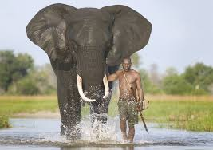
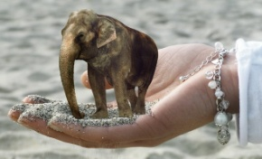
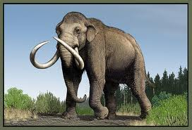
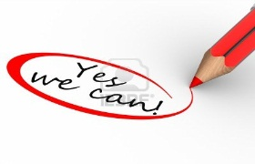
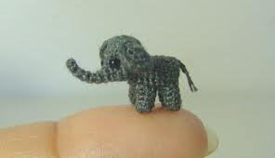
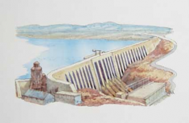
Path for Sustainable Development in Africa
For Off-grid projects
For On-grid projects
Small
Medium
Mini
Micro
Large
Pico
YES WE CAN
Mega
Inevitable
Mammoth Task
Overcome Challenges
Ground Reality
Proposed Grand Inga H.E.P (39,000 MW),
in DR Congo
Through a typical Innovative “7 M” Model
A key to success
(irrespective of project’s magnitude)

Slide 23
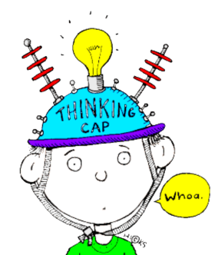
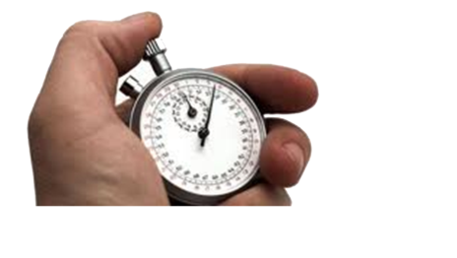
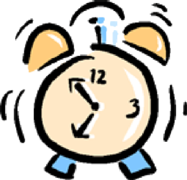
An Innovative “7m model” - Success Mantra
Devised on basis of practical difficulties & experiences of success stories
Money
Manpower
Monitoring
Moment
Master Plan
Machinery / Material
Mid-course correction
Structure of 7 M Model

Slide 24
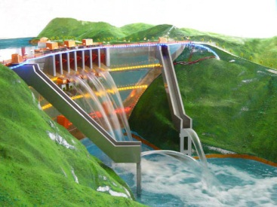
Aspects of the Model
Aspects influencing the functionality of 7M model:
Aspects
of 7M
Model
Technical
Financial
Infrastructure
Policy
Reliable and Bankable Detailed Project Report
Construction Management
Geological Surprises and Challenges
Government Clearances
Selection of Project
Developer
Law & Order / Militancy problems
R&R issues
Training of Manpower
Adequate & continuous Fund for Hydropower development
Relaxation of Duties &Royalties
Approach Roads & Logistics
Equipment Mobilization
Power Supply
Construction Materials

Slide 25
Why Only Wapcos!!!
Renders Turnkey services under one umbrella
(i.e. from conception to commissioning of projects)
In-house core competence for preparation of bankable DPR & project execution
Nodal agency for channelizing services abroad
Association with various Govt. of India premier technical organizations like CEA, CWC, GSI, CSMRS & CWPRS..
Flexibility of associating Private Sector Agencies / Experts
Exclusive software solutions to problems related to Power Engineering projects
Being Government of India arm, ability to address
international issues

Slide 26
Sustainable power development model
Exciting Yet Challenging opportunities await in Africa
Time to Synergise capabilities of India & Africa
Ensuring Sustainable power development model
WAPCOS wish to render any assistance towards achieving the goal of
SUSTAINABLE HYDROPOWER DEVELOPMENT IN AFRICA
16

Slide 27
Your opportunity
Our experience

